Slide 1
THE CHEMISTRY
OF ALDEHYDES AND KETONES

Slide 2
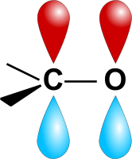
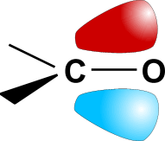

CARBONYL COMPOUNDS - BONDING
Bonding the carbon is sp² hybridised and three sigma (s) bonds are planar
the unhybridised 2p orbital of carbon is at 90° to these
it overlaps with a 2p orbital of oxygen to form a pi (p) bond
as oxygen is more electronegative than carbon the bond is polar
P ORBITAL
ORBITAL OVERLAP
PLANAR WITH BOND ANGLES OF 120°
NEW ORBITAL

Slide 3
CARBONYL COMPOUNDS - STRUCTURE
Structure carbonyl groups consists of
a carbon-oxygen double bond
the bond is polar due to the
difference in electronegativity
Difference ALDEHYDES - at least one H attached to the carbonyl group
KETONES - two carbons attached to the carbonyl group
H
CH₃
C = O
C = O
H
H
CH₃
C₂H₅
C = O
C = O
CH₃
CH₃

Slide 4
CARBONYL COMPOUNDS - FORMULAE
Molecular C₃H₆O
Structural C₂H₅CHO CH₃COCH₃
Displayed
Skeletal
C₂H₅
CH₃
C = O
C = O
H
CH₃
H H H
H O H
H C C C O
H C C C H
H H
H H
O
O

Slide 5
CARBONYL COMPOUNDS - NOMENCLATURE
Aldehydes C₂H₅CHO propanal
Ketones CH₃COCH₃ propanone
CH₃CH₂COCH₃ butanone
CH₃COCH₂CH₂CH₃ pentan-2-one
CH₃CH₂COCH₂CH₃ pentan-3-one
C₆H₅COCH₃ phenylethanone

Slide 6
Formation of carbonyls/oxidation
Oxidation of alcohol using acidified K₂Cr₂O₇
Oxidation of primary alcohols➔ aldehydes
Controlled to avoid further oxidation:
Use excess alcohol over oxidant
Distilling off the aldehyde as it is formed
Oxidation of secondary alcohols➔ ketones
(reflux)

Slide 7
Reduction of carbonyls
Lithium aluminium hydride (LiAlH₄) or H₂+Ni
Aldehyde reduced to primary alcohols
Ketones reduced to secondary alcohols

Slide 8
Nucleophillic addition
Reagent: hydrogen cyanide - HCN
Conditions : in the presence of KCN/NaCN/NaOH
Nucleophile: cyanide ion CN⁻
Product(s) : hydroxynitrile

Slide 9
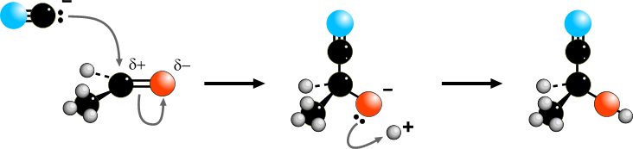
CARBONYL COMPOUNDS - NUCLEOPHILIC ADDITION
Mechanism Nucleophilic addition
Step 1 CN¯ acts as a nucleophile and attacks the slightly positive C
One of the C=O bonds breaks; a pair of electrons goes onto the O
Step 2 A pair of electrons is used to form a bond with H⁺
Overall, there has been addition of HCN
STEP 1
STEP 2

Slide 10
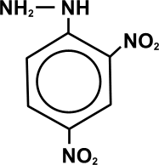
2,4-DINITROPHENYLHYDRAZINE
Structure
Use reacts with carbonyl compounds (aldehydes and ketones)
used as a simple test for aldehydes and ketones
makes orange crystalline derivatives - 2,4-dinitrophenylhydrazones
derivatives have sharp, well-defined melting points
also used to characterise (identify) carbonyl compounds.
Identification / characterisation
A simple way of characterising a compound (finding out what it is) is to
measure the melting point of a solid or the boiling point of a liquid.

Slide 11
CARBONYL COMPOUNDS - IDENTIFICATION
Differentiation to distinguish aldehydes from ketones, use a mild oxidising agent
Tollen’s
Reagent ammoniacal silver nitrate
mild oxidising agent which will oxidise aldehydes but not ketones
contains the diammine silver(I) ion - [Ag(NH₃)₂ ]⁺
the silver(I) ion is reduced to silver Ag⁺(aq) + e¯ ——> Ag(s)
the test is known as THE SILVER MIRROR TEST
Fehling’s
Solution contains a copper(II) complex ion giving a blue solution
on warming, it will oxidise aliphatic (but not aromatic) aldehydes
the copper(II) is reduced to copper(I)
a red precipitate of copper(I) oxide, Cu₂O, is formed
The silver mirror test is the better alternative as it works with all aldehydes
Ketones do not react with Tollen’s Reagent or Fehling’s Solution

Slide 12
